Slide 1

Language Integrated Query in .NET (LINQ)
Operators, Expressions, Projections, Aggregations
Svetlin Nakov
Telerik Corporation
www.telerik.com

Slide 2


Table of Contents
LINQ Building Blocks
Sequences
Query Operators and Expressions
Query Expression Trees
LINQ to Objects
Querying Collections
Projection, Conversion, Aggregation
Sorting, Grouping, Joins, Nested Queries

Slide 3


LINQ Building Blocks

Slide 4

LINQ Building Blocks
Software developers spend a lot of time to obtain and manipulate data
Data can be stored in
Collections
Databases
XML documents
etc...
As of .NET 3.5 developers can use LINQ – a simplified approach to data manipulation

Slide 5
LINQ Building Blocks (2)
LINQ is a set of extensions to .NET Framework
Encompasses language-integrated query, set, and transform operations
Consistent manner to obtain and manipulate "data" in the broad sense of the term
Query expressions can be defined directly within the C# programming language
Used to interact with numerous data types
Converter to expression trees at compile time and evaluated at runtime

Slide 6
LINQ Building Blocks (3)
LINQ allows query expressions to manipulate:
Any object implementing IEnumerable<T>
Collections of objects
Relational databases
XML documents
The query expressions are based on numerous SQL-like query operators
Intentionally designed to look and feel very similar to SQL expressions

Slide 7
LINQ Building Blocks (4)
"LINQ" is the term used to describe this overall approach to data access
LINQ to Objects
LINQ over objects implementing IEnumerable<T>
LINQ to SQL and LINQ to Entities implement LINQ over relational data
LINQ to DataSet is a superset of LINQ to SQL
LINQ to XML is LINQ over XML documents

Slide 8





LINQ to *
C#
VB.NET
Others …
.NET Language-Integrated Query (LINQ)
LINQ enabled data sources
LINQ enabled ADO.NET
LINQ to Objects
LINQ to DataSets
LINQ
to SQL
LINQ to
Entities
LINQ
to XML
<book>
<title/>
<author/>
<price/>
</book>
Objects
Relational Data
XML

Slide 9
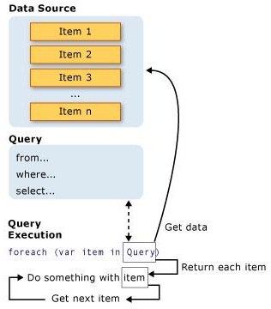
Query Operations
All LINQ query operations consist of three distinct actions:
Obtain the data source
Create the query
Execute the query

Slide 10

LINQ Sequences

Slide 11
IEnumerable<T> and Sequences
The interface IEnumerable<T> is universal LINQ data source
Implemented by arrays and all .NET generic collections
Enables enumerating over a collection of elements
A sequence in LINQ means a collection implementing the IEnumerable<T> interface
Any variable declared as IEnumerable<T> for type T is considered a sequence of type T

Slide 12
IEnumerable<T> and Sequences (2)
Most of the Standard Query Operators are extension methods in the static class System.Linq.Enumerable
Prototyped with an IEnumerable<T> as their first argument
E.g. Min(IEnumerable<T>), Where(IEnumerable<T>, Func<T, bool>)
Use the Cast or OfType operators to perform LINQ queries on legacy, non-generic .NET collections

Slide 13



Query Operators and Expressions

Slide 14
LINQ Query Expressions
When you have a collection of data, a common task is to extract a subset of items based on a given requirement
You want to obtain only the items with names that contain a number
Or don’t have embedded spaces
LINQ query expressions can greatly simplify the process
Query expressions are written in a declarative query syntax introduced in C# 3.0

Slide 15
LINQ Query Expressions (2)
LINQ query expressions are written in a declarative SQL-like syntax
Example: extracting a subset of array containing items with names of more than 6 characters:
string[] games = {"Morrowind", "BioShock", "Daxter",
"The Darkness", "Half Life", "System Shock 2"};
IEnumerable<string> subset =
from g in games
where g.Length > 6
orderby g
select g;
foreach (string s in subset)
Console.WriteLine("Item: {0}", s);

Slide 16

Query Expressions
Live Demo

Slide 17
LINQ Query Expressions (3)
In LINQ a query is a basic language construction
Just like classes, methods and delegates in C#
Query expressions are used to query and transform data from any LINQ-enabled data source
A LINQ query is not executed until
You iterate over the query results
You try to access any of the elements in the result set

Slide 18
Query Operators
Query operators in C# are keywords like:
from, in, where, orderby, select, …
For each standard query operator a corresponding extension method exists
E.g. where → Where(IEnumerable<T>)
At compile time the C# compiler translates query expressions into expression trees
Expression trees are sequences of method calls (from System.Linq.Enumerable)

Slide 19
Query Operators – Syntax
The basic syntax of LINQ queries is:
This selects all elements in games data source
You can apply criteria by the operator where
Any valid C# boolean expression can be used
IEnumerable<string> subset =
from g in games select g;
var subset =
games.Select(g => g);
IEnumerable<string> subset =
from g in games
where g.Price < 20
select g;
var subset =
games.Select(g => g).
Where(g => g.Price < 20);

Slide 20
Query Operators (2)
Two sets of LINQ standard operators
Operating on IEnumerable<T>
Operating on IQueryable<T>
LINQ query operators are shorthand versions for various extension methods
Defined in System.Linq.Enumerable type
Example:
var subset =
from g in games
where g.Price < 20
select g;
IEnumerable<string> subset =
games.Where(g => g.Price < 20);

Slide 21
Query Operators (3)
The standard query operators provide query capabilities including
Filtering – where
Projection – select, selectMany
Aggregation – Sum, Max, Count, Average
Sorting – orderby
Grouping – groupby
… and many more

Slide 22
Standard Query Operators – Example
string[] games = {"Morrowind", "BioShock","Half Life",
"The Darkness","Daxter", "System Shock 2"};
// Build a query expression using extension methods
// granted to the Array via the Enumerable type
var subset = games.Where(game => game.Length > 6).
OrderBy(game => game).Select(game => game);
foreach (var game in subset)
Console.WriteLine(game);
Console.WriteLine();
var subset =
from g in games
where g.Length > 6
orderby g
select g;

Slide 23



Standard Query Operators
Live Demo

Slide 24

Query Expression Trees

Slide 25
Query Expression Trees
A query expression tree is an efficient data structure representing a LINQ expression
Type of abstract syntax tree used for storing parsed expressions from the source code
Lambda expressions often translate into query expression trees
IQueryable<T> is interface implemented by query providers (e.g. LINQ to SQL, LINQ to XML, LINQ to Entities)
IQueryable<T> objects use expression trees

Slide 26
Query Expression Trees (2)
LINQ queries can be performed over two standard .NET interfaces:
IEnumerable<T>
At compile time IL is emitted
IQueryable<T>
At compile time a query expression tree is emitted
Both are evaluated at runtime

Slide 27
Query Expression Trees (3)
When any element of the IQueryable<T> result is being accessed for the first time
A query is generated from the expression tree and is executed
Variable is of type IQueryable<int>
int[] nums = new int[] {
6, 2, 7, 1, 9, 3 };
var numsLessThanFour =
from i in nums
where i < 4
select i;
foreach (var item in numsLessThanFour)
Console.WriteLine(item);
Query is generated and executed here

Slide 28
Expression Trees – Benefits
IQueryable<T> uses expression trees which provide it mechanisms:
For smart decisions and optimizations when query is generated
Based on analysis of expression trees
Optimizing multiple nested or complex queries
Combining multiple queries into very efficient single one

Slide 29



LINQ to Objects

Slide 30
LINQ to Objects
LINQ to Objects refers to using LINQ queries directly over IEnumerable<T> collection
Without the an intermediate LINQ provider or API, such as LINQ to SQL or LINQ to XML
Applicable to any enumerable collection
The old school data retrieval approach
Write complex foreach loops that specify how to retrieve data from a collection
Тhe LINQ approach – write declarative code that describes what to be retrieved

Slide 31
LINQ to Objects – Advantages
LINQ queries offer three main advantages over traditional foreach loops
They are more concise and easy-to-read
Especially when filtering by multiple conditions
Provide powerful filtering, ordering, and grouping capabilities
Can be ported to other data sources with little or no modification

Slide 32
LINQ to Objects – Example
LINQ to Objects is performing SQL-like queries on in-memory data collections and arrays
string[] presidents = { "Adams", "Arthur", "Buchanan",
"Bush", "Carter","Cleveland","Clinton", "Coolidge",
"Eisenhower", "Fillmore", "Ford", "Garfield","Grant",
"Harding", "Harrison", "Hayes", "Hoover", "Jackson",
"Jefferson", "Johnson", "Kennedy", "Lincoln",
"Madison", "McKinley", "Monroe", "Nixon", "Pierce",
"Polk", "Reagan", "Roosevelt", "Taft", "Taylor",
"Truman", "Tyler", "Van Buren", "Washington",
"Wilson"};
string president =
presidents.Where(p => p.StartsWith("Lin")).First();
Console.WriteLine(president);
string president =
(from p in presidents
where p.StartsWith("Lin")
select p).First();

Slide 33

LINQ to Objects
Live Demo

Slide 34
Counting the Occurrences of a Word in a String – Example
string text = "Historically, the world of data …";
…
string searchTerm = "data";
string[] source = text.Split(
new char[] { '.', '?', '!', ' ', ';', ':', ',' },
StringSplitOptions.RemoveEmptyEntries);
// Use ToLower() to match both "data" and "Data"
var matchQuery =
from word in text
where word.ToLower() == searchTerm.ToLower()
select word;
int wordCount =
matchQuery.Count();
int wordCount = text.Select(
w => w.toLower() ==
searchTerm.ToLower()).Count();

Slide 35
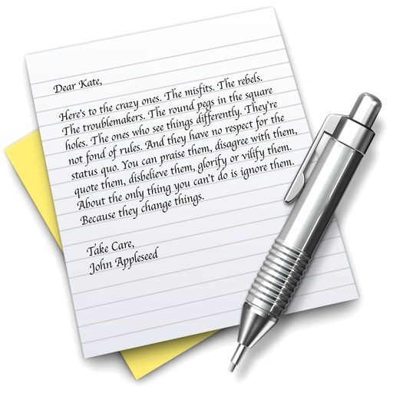

Count the Occurrences of a Word in a String
Live Demo

Slide 36


Querying Collections

Slide 37
Querying Collections
What can we query?
Not everything can be queried by LINQ to Objects
The objects need to be a collection
It must implement the IEnumerable<T> interface
The good news
Almost all standard collections in .NET Framework implements IEnumerable<T>

Slide 38
Querying Collections (2)
What can be queried using LINQ to Objects?
Arrays – T[]
Generic lists – List<T>
Generic dictionaries – Dictionary<K,V>
Strings – string
Other collections that implements IEnumerable<T>

Slide 39
Querying Arrays
Any kind of arrays can be used with LINQ
Can be even an untyped array of objects
Queries can be applied to arrays of custom objects
Example:
var titles =
from b in books
where b.Title.Contains("Action")
select b.Title;
Book[] books = {
new Book { Title="LINQ in Action" },
new Book { Title="LINQ for Fun" },
new Book { Title="Extreme LINQ" } };
var titles = books
.Where(book => book.Title.Contains("Action"))
.Select(book => book.Title);

Slide 40
Querying Generic Lists
The previous example can be adapted to work with a generic list
List<T>, LinkedList<T>, Queue<T>, Stack<T>, HashSet<T>, etc.
List<Book> books = new List<Book>() {
new Book { Title="LINQ in Action" },
new Book { Title="LINQ for Fun" },
new Book { Title="Extreme LINQ" } };
var titles = books
.Where(book => book.Title.Contains("Action"))
.Select(book => book.Title);

Slide 41

Querying Generic Lists
Live Demo

Slide 42
Querying Strings
Although System.String may not be perceived as a collection at first sight
It actually is a collection, because it implements IEnumerable<char>
String objects can be queried with LINQ to Objects, like any other collection
var count = "Non-letter characters in this string: 8"
.Where(c => !Char.IsLetter(c))
.Count();
Console.WriteLine(count);
// The result is: 8
var count =
(from c in "Non-letter…"
where !Char.IsLetter(c)
select c).Count();

Slide 43

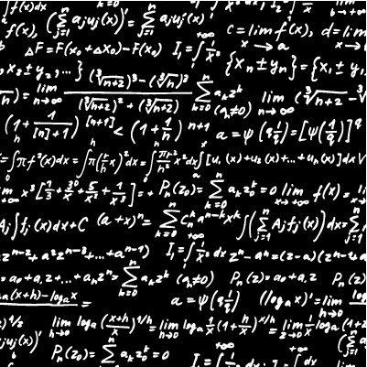

LINQ Operations

Slide 44

Aggregation Operations
An aggregation operation computes a single value from a collection of values
Example of aggregation of field over a sequence of employees
Name | Salary
Bay Ivan | 12500,00
Bat Rambo | 13500,00
Baba Yaga | 43300,00
Kiro the King | 29800,00
Bay Mangal | 25000,00
... | ...
MAX(Salary)
125500,00

Slide 45
Aggregation Methods
Average()
Calculates the average value of a collection
Count()
Counts the elements in a collection
Max()
Determines the maximum value in a collection
Sum()
Sums the values in a collection

Slide 46
Aggregation Methods – Examples
Count(<condition>)
Max()
double[] temperatures =
{28.0, 19.5, 32.3, 33.6, 26.5, 29.7};
int highTempCount = temperatures.Count(p => p > 30);
Console.WriteLine(highTempCount);
// The result is: 2
var highTemp =
(from p in temperatures
where p > 30
select p).Count();
double[] temperatures =
{28.0, 19.5, 32.3, 33.6, 26.5, 29.7};
double maxTemp = temperatures.Max();
Console.WriteLine(maxTemp);
// The result is: 33.6
var highTemp =
(from p in temperatures
select p).Max();

Slide 47
Projections
Projection refers to the act of transforming the elements of a collection into a different type
The resulting type is deﬁned by the developer
Projection operators in LINQ
Select – projects single values that are based on a transform function
SelectMany – projects collections of values into a new collection containing all values

Slide 48
Projections – Examples
Select(<transform-function))
List<string> words =
new List<string>() { "an", "apple", "a", "day" };
var query =
from word in words
select word.Substring(0, 1);
foreach (string s in query)
{
Console.Write("{0} ",s);
}
// The result is: a a a d
var query =
words.Select(w =>
w.Substring(0,1));

Slide 49
Projections – Examples (2)
SelectMany(<multi-value-function>)
string[] sentence = new string[] {
"The quick brown",
"fox jumped over",
"the lazy dog"};
// SelectMany returns nine strings
// (sub-iterates the Select result)
IEnumerable<string> allWords =
sentence.SelectMany(segment => segment.Split(' '));
foreach (var word in allWords)
Console.WriteLine(" {0}", word);
// Result: The quick brown fox jumped over the lazy dog

Slide 50



Projections
Live Demo
LINQ

Slide 51
Conversions
Converting a collection to a different type
Can change the type of the collection
Can change the type of the elements
Conversion operations in LINQ queries are useful in a variety of applications
For example:
Enumerable.AsEnumerable<TSource>
Enumerable.OfType<(TResult)>
Enumerable.ToArray(TSource)

Slide 52
Conversion Methods
If start with "As"
Change the static type of the source collection but do not enumerate it
If start with "To"
Enumerate the source collection and turn each item into the corresponding collection type
string[] towns =
{"Sofia", "Plovdiv", "Varna", "Bourgas", "Pleven"};
List<string> list = towns.ToList();

Slide 53
Sorting
A sorting operation orders the elements of a sequence based on one or more attributes
Standard query operator
OrderBy(…)
OrderByDescending(…)
ThenBy(…) – performs a secondary sort in ascending order
ThenByDescending(…)
Reverse(…)

Slide 54
Sorting – Example
string[] words = { "Bay Kolio", "Pinokio",
"Dedo Mraz", "Baba Yaga", "Bay Mangal" };
IEnumerable<string> query =
from word in words
orderby word.Length, word.Substring(0, 1) descending
select word;
foreach (string str in query)
Console.WriteLine(str);
/* The result is:
Pinokio
Dedo Mraz
Bay Kolio
Baba Yaga
Bay Mangal
*/
var query =
words.Select(word => word).
OrderBy(word => word.Length).
ThenByDescending(
word => word.Substring(0, 1));

Slide 55
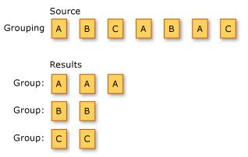
Grouping
Operation of putting data into groups
The elements in each group share a common value for some attribute
Example

Slide 56
Creating Groups and Maps
GroupBy()
Groups elements that share a common attribute, called key
Each group is represented by a sequence of IGrouping(TKey,TElement) objects
ToLookup()
Inserts elements into a Lookup(TKey, TElement) based on a key selector function
Distinct()
Returns distinct elements form a collection

Slide 57
Group By – Examples
var people = new[] {
new { Name = "Kiki", Town = "Plovdiv"},
new { Name = "Pepi", Town = "Sofia"},
new { Name = "Koko", Town = "Sofia"},
new { Name = "Mimi", Town = "Plovdiv"}
};
var peopleByTowns =
from p in people
group p by p.Town;
foreach (var town in peopleByTowns)
{
Console.Write("Town {0}: ", town.Key);
foreach (var person in town)
Console.Write("{0} ", person.Name);
Console.WriteLine();
}
var peopleByTowns =
people.GroupBy(t => t.Town);

Slide 58
Group By – Examples (2)
int[] numbers = { 5, 4, 1, 3, 9, 8, 6, 7, 2, 0 };
var numberGroups =
from n in numbers
group n by n % 3;
foreach (var g in numberGroups)
{
Console.Write("Remainder: {0} -> ", g.Key);
foreach (var n in g)
Console.Write("{0} ", n);
Console.WriteLine();
}
// Remainder: 2 -> 5 8 2
// Remainder: 1 -> 4 1 7
// Remainder: 0 -> 3 9 6 0
var numberGroups =
numbers.GroupBy(n => n % 3);

Slide 59
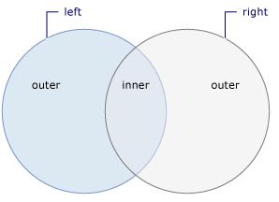

Joins
Action of relating or associating one data source object with a second data source object
The two data source objects are associated through a common value or attribute

Slide 60
Join Methods
Join
Joins two sequences based on key selector function
And extracts the joined pairs of values
GroupJoin
Joins two sequences based on key selector functions
And groups the resulting matches for each element

Slide 61
Joins – Example
var owners = new[] {
new { Name = "Koko", Town = "Plovdiv"},
new { Name = "Pepi", Town = "Sofia"},
};
var pets = new[] {
new { Name = "Sharo", Owner = owners[0] },
new { Name = "Rex", Owner = owners[1] },
new { Name = "Poohy", Owner = owners[0] },
};
var petsWithOwners =
from o in owners
join p in pets on o.Name equals p.Owner.Name
select new { Owner = o.Name, Pet = p.Name };
foreach (var p in petsWithOwners)
Console.WriteLine("{0} owned by {1}", p.Pet, p.Owner);
var petsWithOwners = owners.Join(pets,
(o => o.Name), (p => p.Owner.Name),
(o, p) => new {o.Name, p.Name });

Slide 62


Joins
Live Demo

Slide 63
Nested Queries
The queries can be nested
For example:
Suppose we have collections of Person and collections of Role objects
We want get all roles for given person (ID = 1)
var query = people
.Where(p => p.ID == 1)
.SelectMany(p => roles
.Where(r => r.ID == p.RoleID)
.Select(r =>
new { p.FirstName, p.LastName, r.Role }));

Slide 64

Nested Queries
Live Demo

Slide 65

Language Integrated Query in .NET (LINQ)
Questions?

Slide 66
Homework
Create a class student with properties FirstName, LastName, FN, Tel, Email, Marks (a List<int>), GroupNumber. Create a List<Student> with sample students. Select only the students that are from group number 2. Use LINQ query. Order the students by FirstName.
Implement the previous using the same query expressed with extension methods.
Extract all students that have email in abv.bg. Use string methods and LINQ.
Extract all students with phones in Sofia. Use LINQ and regular expressions.

Slide 67
Homework (2)
Select all students that have at least one mark Excellent (6) into a new anonymous class that has properties – FullName and Marks. Use LINQ.
Write down a similar program that extracts the students with exactly two marks "2". Use extension methods.
Extract all Marks of the students that enrolled in 2006. (The students from 2006 have 06 as their 5-th and 6-th digit in the FN).
Create a class Group with properties GroupNumber and DepartmentName. Introduce a property Group in the Student class. Extract all students from "Mathematics" department. Use the Join operator.

Slide 68
Homework (3)
Write a program to return the string with maximum length from an array of strings. Use LINQ.
Create a program that extracts all students grouped by GroupName and then prints them to the console. Use LINQ.
Rewrite the previous using extension methods.

